Slide 1
Optimizing and Interpreting Deep Learning for IoT Security: An Explainable AI (XAI)Framework for Bi-LSTM-Based Intrusion Detection
Mursaline Huqe
ID : 0242220005101804
Department : CSE
Daffodil International University

Slide 2
Outline
Introduction
Objective
Background Study
Gap Analysis
Methodology
Results & Analysis
Novelty of the Work
Conclusion
References

Slide 3
Introduction
IoT now powers homes, industry, and critical infrastructure, but every connected device is a potential entry point for cyber attacks.
Common threats include Mirai botnets, DoS floods, port scans, and MITM ARP spoofing on the IoTID20 benchmark Dataset.
Deep-learning intrusion detection at the edge faces three challenges: large model size, black-box opacity, and adversarial evasion.
This project proposes a lightweight Attention-BiLSTM framework, compressing 69 features to 15 (78.3% reduction) for real-time detection.
Adversarial (PGD-10) training and SHAP explainability add robustness and turn alerts into trustworthy forensic insights.

Slide 4
Objective
Feature Selection & Compression: Condense 69-dimensional telemetry to a 15-feature subspace, balancing ultra-low latency with multi-class accuracy.
Class-Balanced Permutation Importance inverse-frequency (macro-F1) weighting recovers rare-attack features (e.g. MITM ARP <2%)
CREA projection preserves physical network meaning → 1.49 MB footprint, <0.04 ms/sample inference
Attention-Bi-LSTM : Train a Bidirectional LSTM with dot-product Self-Attention for 5-class detection (Normal, Mirai, DoS, Scan, MITM) on IoTID20.
Target <2.0 MB parameter footprint deployable on low-cost IoT gateways
Real-time inference at <0.04 ms mean latency per sample
Adversarial Evasion Hardening: Apply a Madry minimax attacker-defender loop to harden decision boundaries against FGSM/PGD white-box evasion.
50% of each training batch to convert brittle statistical cues into robust structural patterns
Optimizes the accuracy-robustness trade-off to preserve clean-data performance
Explainable AI (XAI) for Security Forensics: Integrate the SHAP KernelExplainer to turn black-box alerts into analyst-ready forensic evidence.
Global beeswarm plots : feature distributions driving each threat class
Local waterfall charts : packet-level attribution delivered with real-time alerts

Slide 5
Background Study
Ref. | Authors (Year) | Methodology | Performance Summary | Limitation / Technical Gaps
[1] | Ullah & Mahmoud (2020) | Physical smart-home testbed utilizing the MQTT protocol to generate an IoT benchmark. | Generated the IoTID20 benchmark dataset containing 625,783 records with 83 network features. | Dataset generation only; fails to propose a deep sequence model or establish a <2MB edge gateway baseline.
[9] | Islam et al. (2021) | Bidirectional LSTM (Bi-LSTM) trained on 69 features of the IoTID20 dataset. | Achieved 99.996% binary accuracy on IoTID20; resulted in a 4.26 MB model size footprint. | Fails to meet <2MB edge gateway constraints (4.26 MB); lacks adversarial PGD-10 hardening and XAI transparency.
[17] | Al-Shibly et al. (2026) | Hybrid CNN-BiLSTM with Permutation Importance (PI) feature selection on CIC IIoT 2025. | Reduced feature space to K=20; achieved 0.9720 accuracy and 0.9719 F1-score. | Lacks adversarial PGD-10 hardening (susceptible to gradient-based evasion); does not apply SHAP for packet-level forensic explanation.
[2] | Akintade et al. (2023) | XGBoost with Permutation Importance (PI) alongside SHAP/LIME on NSL-KDD and CCID-V1. | Reduced NSL-KDD features from 42 to 20; achieved 0.8751 AUC in 4.49 seconds runtime. | Applies SHAP only to shallow trees (XGBoost), not deep sequence models; lacks adversarial evaluation.

Slide 6
Background Study (Cont.)
Ref. | Authors (Year) | Methodology | Performance Summary | Limitation / Technical Gaps
[36] | Sadhwani et al. (2025) | Hybrid BiLSTM-CNN for spatial-temporal extraction over the UNSW-NB15 dataset. | Achieved 97.51% accuracy, 99.265% precision, 93.091% F1-score, and 8.857% Miscalculation Rate. | Lacks adversarial PGD-10 hardening; no SHAP explainability layer for alert validation.
[6] | Madry et al. (2018) | Projected Gradient Descent (PGD) minimax adversarial training framework. | Defines adversarial robustness against L∞ norm ball perturbations at ε=0.05. | Purely mathematical robustness optimization; fails to address <2MB edge gateway constraints or post-hoc SHAP explainability.
[34] | Tsipras et al. (2019) | Mathematical formulation of the accuracy-robustness tradeoff under adversarial training. | Proves a mandatory 4% to 8% standard classification accuracy drop is required for structural defense. | Theoretical framework without empirical IoT deployment, feature compression, or SHAP integration.
[4] | Lundberg & Lee (2017) | SHapley Additive exPlanations (SHAP) framework utilizing KernelExplainer. | Computes unique additive feature attributions for black-box models based on game theory. | General framework; lacks native integration for IoT network packet forensics and adversarial robustness contexts.

Slide 7
Gap Analysis
None of the reviewed NIDS satisfy all three edge requirements simultaneously:
Memory constraint: uncompressed Bi-LSTMs exceed 4 MB over the <2 MB edge-gateway.
Interpretability loss: PCA-style reduction destroys feature semantics, blocking SHAP forensic explanation.
Adversarial fragility: without PGD-10 hardening, accuracy collapses under FGSM/PGD gradient evasion.
Requirement | Rule IDS | Standard ML IDS | Unoptimized DL IDS | Explainable NIDS | Proposed Framework
Zero-Day Detection | No | Moderate | Yes | Yes | Yes
Edge Footprint (<2.0 MB) | Yes | Yes | No (4.26 MB) | No (3.63 MB) | Yes (1.49 MB)
Adversarial Hardening | N/A | None | None | None | PGD-10 (75.36%)
Local SHAP Explanations | No | No | No | Yes | Yes
Semantic Interpretability | High | High | Low | Low (PCA) | High (PI+CREA)

Slide 8
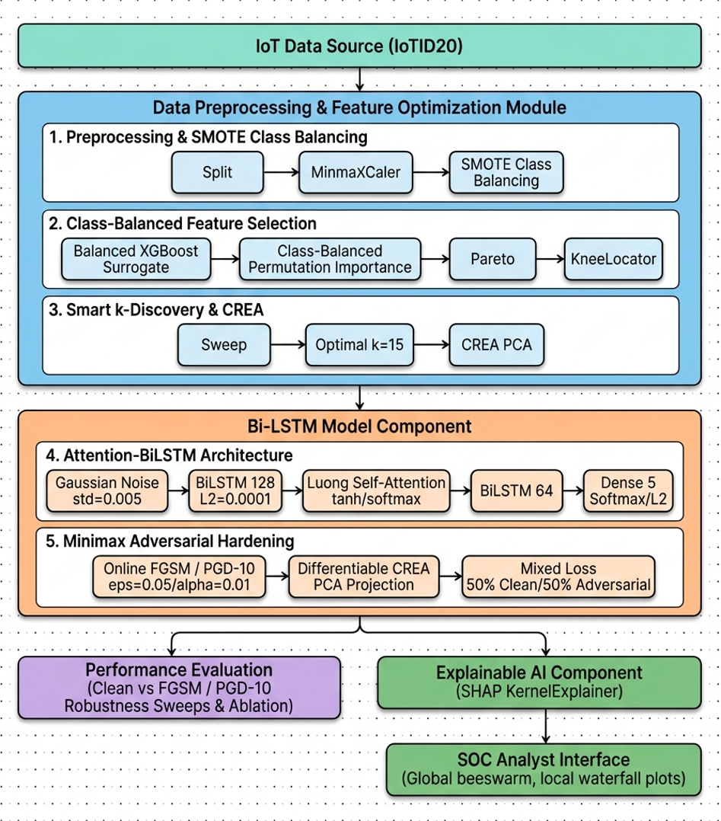
Methodology
Preprocessing: drops leakage columns (Cat, Sub_Cat), keeps a stratified 80/20 split, and MinMax-scales to one range, applying SMOTE to the training split only so rare attacks (MITM ARP < 2%) become learnable without leaking into the test set.
Feature selection: an XGBoost surrogate with inverse-frequency class weights scores all 69 features by the macro-F1 drop when each is shuffled, narrowing them to the 15 that carry real multi-class signal from pareto k subsets.
CREA alignment: sweeps k from 1 to 69 to the Kneedle inflection, compresses to 15 features while eigenspace alignment keeps their physical network meaning, then reshapes into a sequence tensor readable later, unlike PCA.
Attention-BiLSTM: reads each flow forward and backward with 64-unit LSTMs, lets Luong self-attention weight the packets that mark an attack, and closes with dropout and a 5-class softmax under a 2 MB footprint.
Adversarial hardening: Madry PGD-10 minimax training perturbs half of every batch (budget 0.05, step 0.0125, 10 steps) to rebuild decision boundaries against white-box evasion, trading a little clean accuracy for real resistance.
SHAP explanation: a KernelExplainer over a 100-sample background ships each alert with the exact features that triggered it a global beeswarm and a per-alert waterfall giving analysts evidence instead of a black-box verdict.

Slide 9
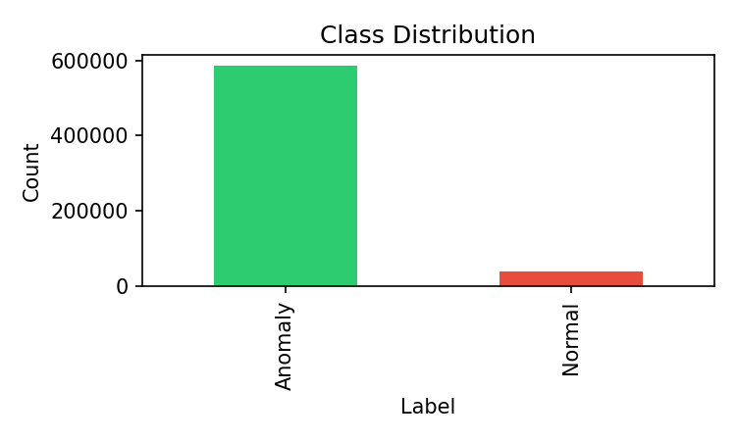
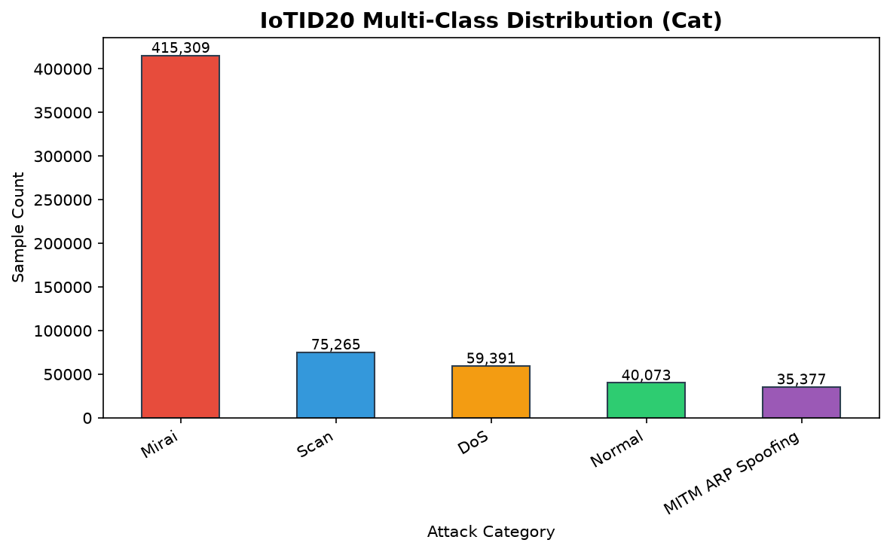
Dataset & Preprocessing
IoTID20 Dataset
Source: real smart-home testbed (Univ. of Ontario) , SKT NUGU AI speaker and EZVIZ Wi-Fi camera behind an Orange Pi gateway running MQTT, with flows extracted using CICFlowMeter.
Scale: 625,783 flow records described by 83 numerical features plus 3 metadata columns.
Attack types: Mirai botnet, Denial of Service, Scan, and MITM ARP spoofing set against benign traffic.
Class distribution: Mirai 66%, DoS 15%, Normal 15%, Scan 4%, and MITM ARP spoofing < 2% a severely imbalanced mix.
Preprocessing
Stratified split: an 80/20 train-test split (500,332 train / 125,083 test) that preserves the original class ratios.
MinMax scaling: features normalized strictly to [0, 1], fitting the scaler on the training split only to prevent data leakage.
SMOTE oversampling: synthetic oversampling (k = 5 neighbors) on the training split only, lifting the minority MITM ARP class from < 2% toward the majority; the test split is never oversampled.

Slide 10
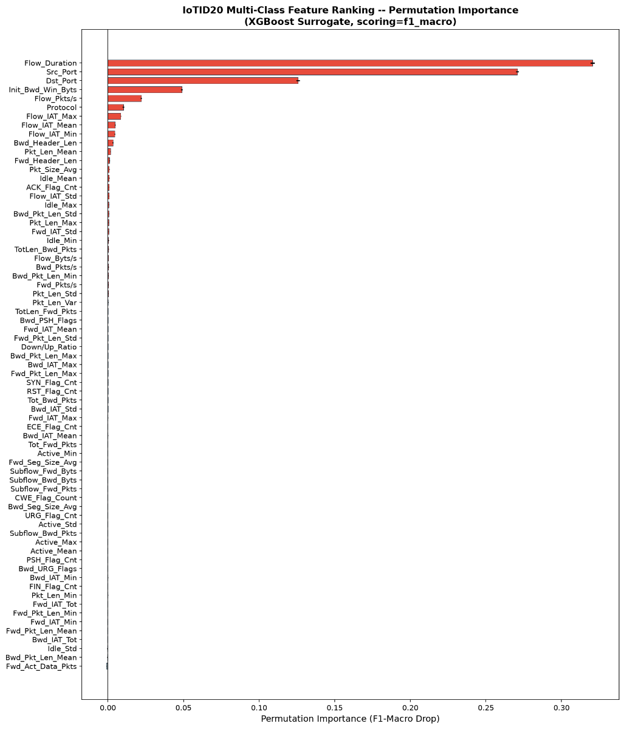
Result and Analysis
Class-Balanced Permutation Importance scores for all 69 IoTID20 features, sorted by macro-averaged feature importance.
Rank | Feature | PI Score | Rank | Feature | PI Score
1 | Flow_Duration | 0.3204 | 11 | Pkt_Len_Mean | 0.0017
2 | Src_Port | 0.2708 | 12 | Fwd_Header_Len | 0.0010
3 | Dst_Port | 0.1258 | 13 | Pkt_Size_Avg | 0.0009
4 | Init_Bwd_Win_Byts | 0.0488 | 14 | Idle_Mean | 0.0008
5 | Flow_Pkts/s | 0.0221 | 15 | ACK_Flag_Cnt | 0.0008
6 | Protocol | 0.0103 | 16 | Flow_IAT_Std | 0.0007
7 | Flow_IAT_Max | 0.0085 | 17 | Idle_Max | 0.0006
8 | Flow_IAT_Mean | 0.0048 | 18 | Bwd_Pkt_Len_Std | 0.0006
9 | Flow_IAT_Min | 0.0045 | 19 | Pkt_Len_Max | 0.0006
10 | Bwd_Header_Len | 0.0033 | 20 | Fwd_IAT_Std | 0.0005

Slide 11
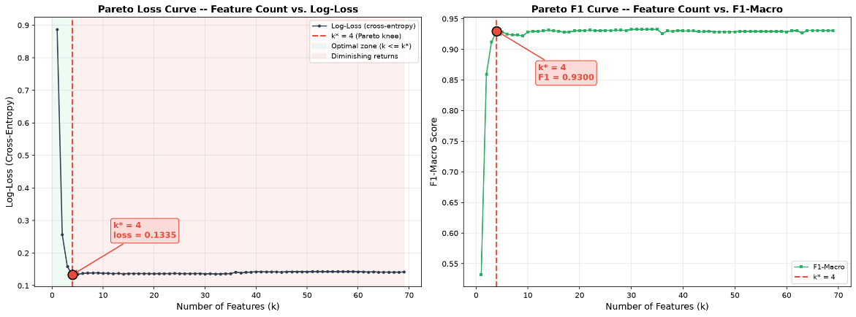
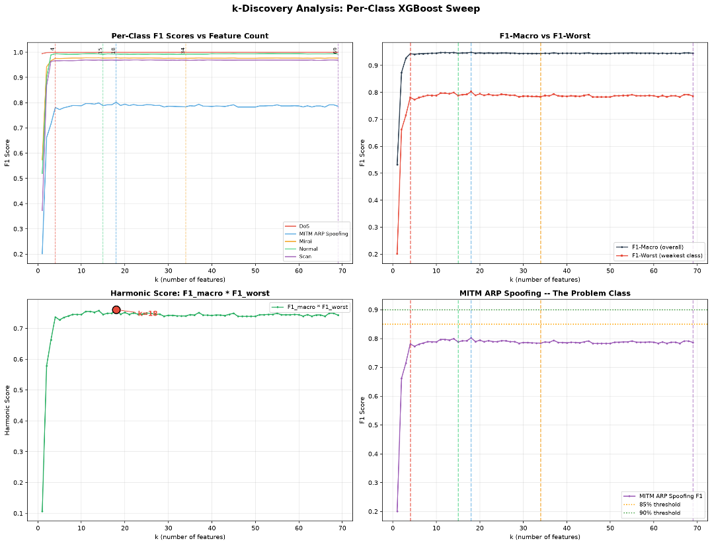
Result and Analysis
Feature Selection & k-Discovery
Class-balanced ranking: applying PI scored all 69 features with an XGBoost surrogate using inverse class-frequency weights, protecting rare attacks such as MITM.
Sequential validation: pareto swept candidate subsets (k = 4, 15, 18, 34, 69) through the full Bi-LSTM to test real sequence-learning ability, not just surrogate scores.
The discovery: k = 18 peaked in the shallow surrogate but collapsed under deep sequential modeling, so k = 15 stands as the optimal subset.
Candidate (k) | Mathematical Criterion | XGBoost Surrogate Harmonic Score | Bi-LSTM Accuracy | Bi-LSTM F1-Macro | Bi-LSTM F1-Worst (MITM) | Bi-LSTM Harmonic Score | Status / Decision
k = 4 | Knee Inflection (Pareto) | 0.7369 | 92.13% | 0.8951 | 0.6433 | 0.5759 | Rejected (Underfitting)
k = 15 | Optimal Inflection Point | 0.7449 | 94.00% | 0.9152 | 0.6996 | 0.6402 | SELECTED
k = 18 | Peak Surrogate Score | 0.7607 | 92.17% | 0.8958 | 0.6329 | 0.5670 | Rejected (Sequence Collapse)
k = 34 | Peak Surrogate F1-Macro | 0.7401 | 93.40% | 0.9098 | 0.6899 | 0.6277 | Rejected (High Footprint)
k = 69 | Full Feature Baseline | 0.7428 | 93.53% | 0.9098 | 0.6891 | 0.6269 | Rejected (Too Complex)

Slide 12
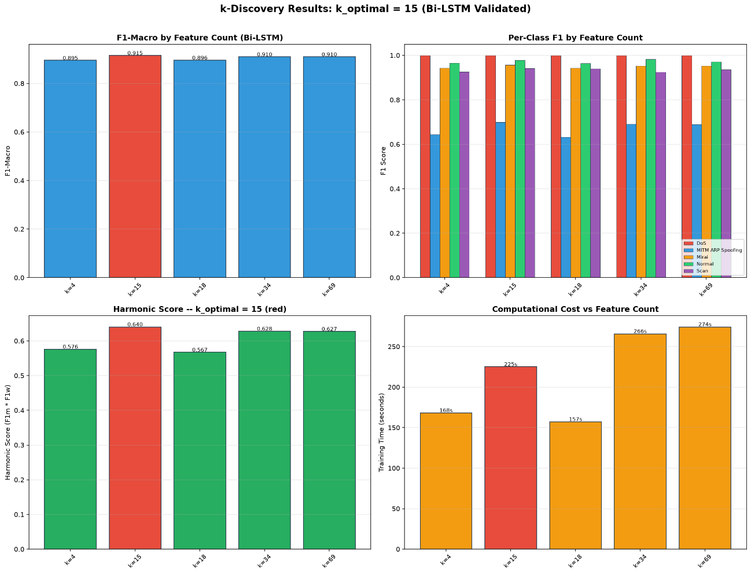
Result and Analysis
Feature Selection: PI Optimal Subset (k = 15: 69 → 15 features = 78.3% compression)
Rank | Feature Name | Description | Category
1 | Flow_Duration | Total duration of the network flow in microseconds | Temporal
2 | Src_Port | Source port number identifying the origin application | Network
3 | Dst_Port | Destination port number identifying the target application | Network
4 | Init_Bwd_Win_Byts | Number of bytes sent in the initial backward TCP window | Size
5 | Flow_Pkts/s | Number of packets transmitted per second | Rate
6 | Protocol | Transport layer protocol (e.g., TCP, UDP) | Network
7 | Flow_IAT_Max | Maximum inter-arrival time between two packets | Temporal
8 | Flow_IAT_Mean | Mean inter-arrival time between consecutive packets | Temporal
9 | Flow_IAT_Min | Minimum inter-arrival time between two packets | Temporal
10 | Bwd_Header_Len | Total header byte length in the backward direction | Size
11 | Pkt_Len_Mean | Average byte length of packets in the flow | Size
12 | Fwd_Header_Len | Total header byte length in the forward direction | Size
13 | Pkt_Size_Avg | Average size of the packets across the entire flow | Size
14 | Idle_Mean | Average time the flow was idle before becoming active | Temporal
15 | ACK_Flag_Cnt | Number of packets with the Acknowledgment flag set | Flag
Accuracy and macro-F1 comparison for feature subsets k in [4, 15, 18, 34, 69] across evaluated architectures.

Slide 13
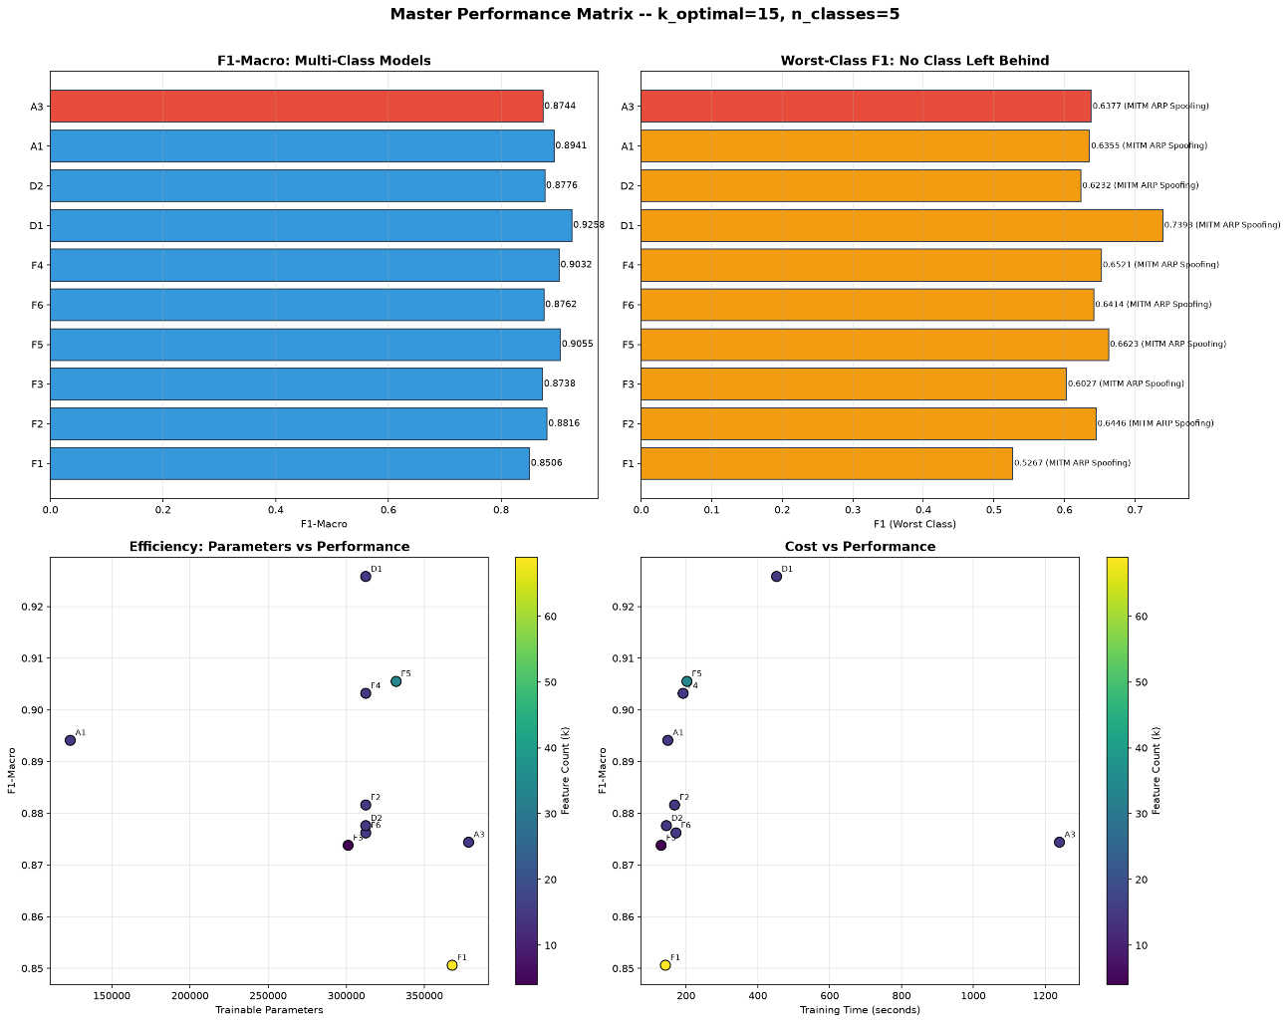
Result and Analysis
Classification: Regular Bi-LSTM (69 feat) vs. Optimized PI + CREA (15 feat)
Binary Classification
Metric | Regular Bi-LSTM (69) | Optimized PI+CREA (15) | Change
Features | 69 | 15 | -78.3%
Accuracy | 99.64% | 99.81% | +0.17%
Precision | 0.9982 | 0.9988 | +0.0006
Recall | 0.9979 | 0.9992 | +0.0013
F1-Score | 0.9981 | 0.9990 | +0.0009
Parameters | 367,233 | 311,937 | -15.1%
Model Size | 4.26 MB | 3.63 MB | -14.8%
Latency | 0.0263 ms | 0.0247 ms | -6.1%
Multi-Class Classification
Metric | Regular Bi-LSTM (69) | Optimized PI+CREA (15) | Change
Features | 69 | 15 | -78.3%
Accuracy | 89.44% | 92.80% | +3.36%
Precision (Macro) | 0.8194 | 0.8765 | +0.0571
Recall (Macro) | 0.9079 | 0.9654 | +0.0575
F1-Macro | 0.8506 | 0.9032 | +0.0526
F1-Worst (MITM) | 0.5267 | 0.6521 | +0.1254
Parameters | 367,749 | 312,453 | -15.0%
Model Size | 4.26 MB | 3.63 MB | -14.8%
Latency | 0.0305 ms | 0.0265 ms | -13.1%
Class-weighted PI preserved the rare MITM ARP class (<2% of data), lifting its F1 by +0.1254.

Slide 14
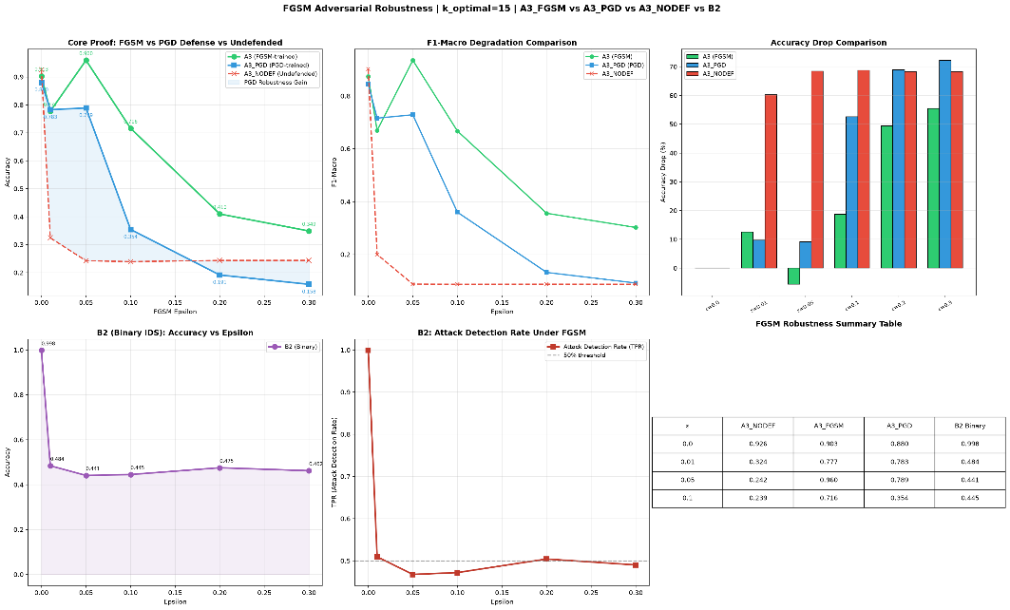
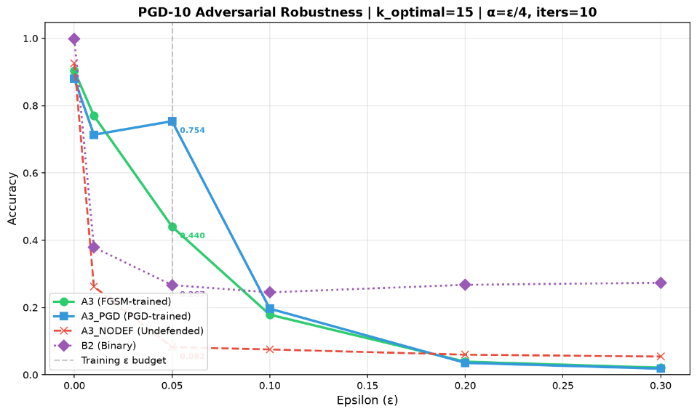
Result and Analysis
Adversarial Robustness — Architecture Ablation & PGD-10 Defense
Architectural Ablation (PI + CREA, k = 15)
Architecture | Accuracy | F1-Macro | F1-Worst (MITM) | Parameters | Model Size | Latency (ms)
Standard LSTM (Unidirectional) | 92.07% | 0.8941 | 0.6355 | 123,461 | 1.45 MB | 0.0222
Standard Bidirectional LSTM | 92.80% | 0.9032 | 0.6521 | 312,453 | 3.63 MB | 0.0265
Attention-BiLSTM (Proposed) | 92.62% | 0.9011 | 0.6456 | 378,245 | 1.49 MB | 0.0357
Attention-BiLSTM is the only architecture meeting both the <2.0 MB edge constraint and Bi-LSTM-level accuracy.
PGD-10 Robustness Summary (ε = 0.05)
Model Variant | Clean Acc | PGD-10 Acc (ε=0.05) | Acc Drop | Robustness Gain
Undefended Attention-BiLSTM | 92.62% | 8.21% | -84.41% | — baseline
FGSM-Trained Attention-BiLSTM | 90.32% | 44.04% | -46.28% | +35.83 pp
PGD-Trained Attention-BiLSTM (Final) | 87.99% | 75.36% | -12.63% | +67.15 pp
A -4.63% clean-accuracy concession delivers +67.15 pp PGD-10 robustness — adversarial training is a security imperative.

Slide 15
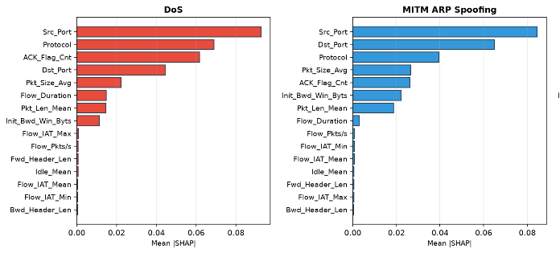

Result and Analysis
Explainable AI — SHAP Kernel Explainer (Transparent Threat Alerts)
SHAP KernelExplainer computes each feature's Shapley contribution over a stratified background of 400 training samples across all 5 classes.
Class-Specific SHAP Signatures
Attack Class | Primary SHAP Signature | Physical Interpretation
Mirai Botnet | Src_Port, Protocol, Dst_Port | Algorithmic scanning of specific vulnerable destination ports (e.g., Telnet) over targeted protocols for C2 propagation.
Denial of Service | Src_Port, Protocol, ACK_Flag_Cnt | High-volume protocol exploitation using spoofed source ports and manipulated ACK flags to overwhelm target sensors.
MITM ARP Spoofing | Src_Port, Dst_Port, Protocol | Forged localized routing packets bypassing standard application port mapping to intercept subnet traffic.
Scan / Port Sweep | Src_Port, Dst_Port, ACK_Flag_Cnt | Rapid, sequential reconnaissance pinging across multiple destination network ports, generating abnormal ACK flag responses.
Normal Traffic | Dst_Port, Src_Port, Pkt_Size_Avg | Standard, expected routing ports with regular packet size distributions representing normal browsing communication.

Slide 16
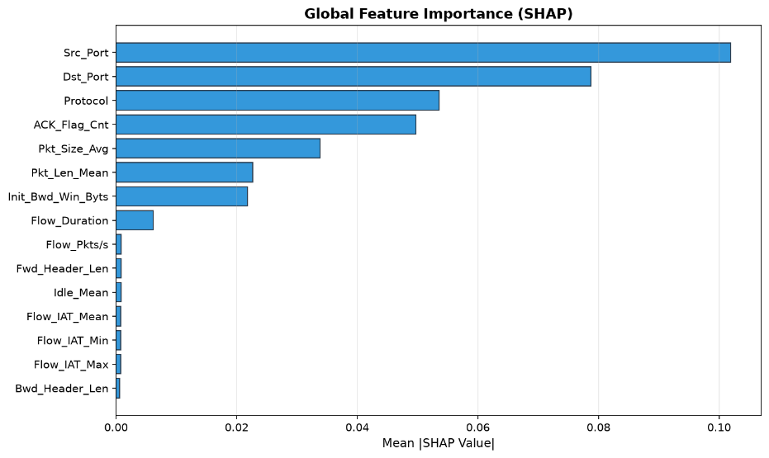
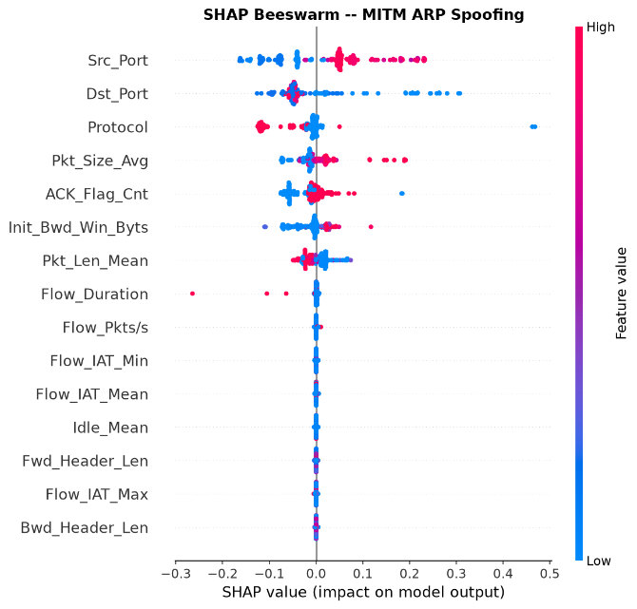
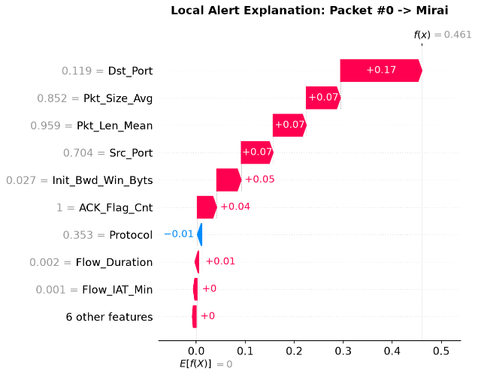
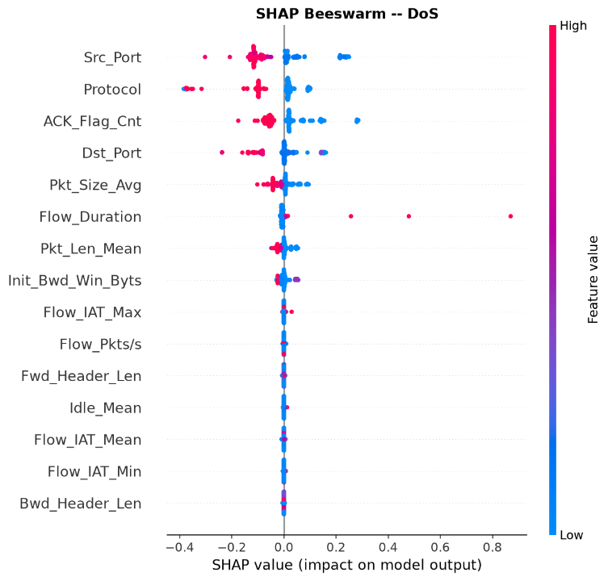
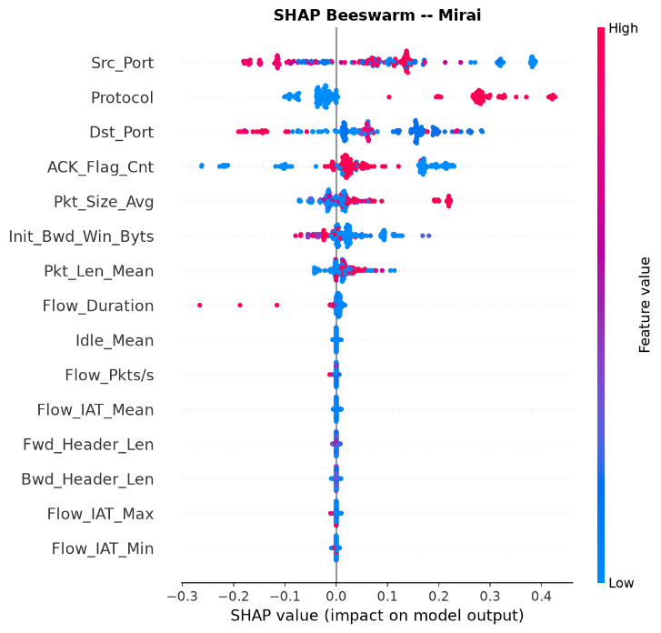
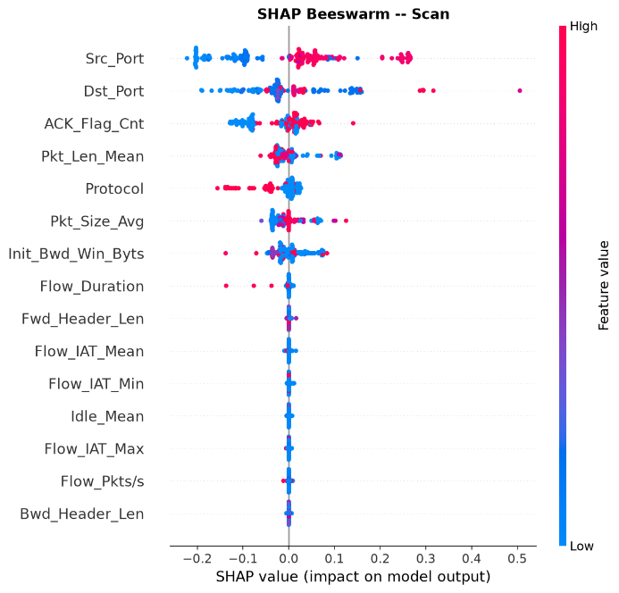
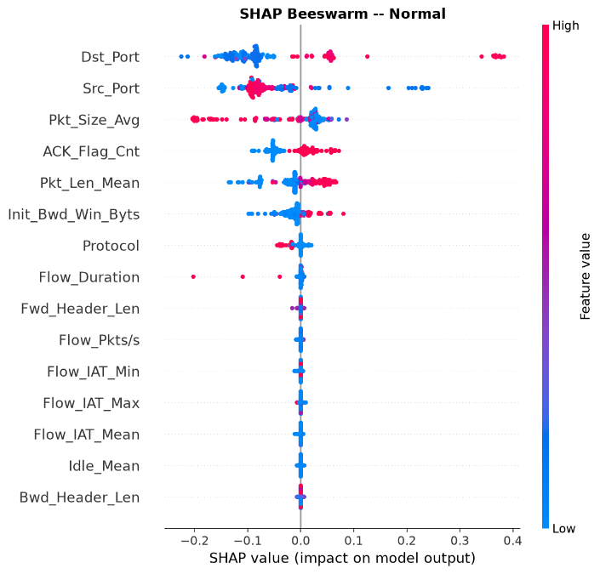
Result and Analysis

Slide 17
Novelty of the Work
Simultaneous 3-Way Optimization: First network intrusion detection system (NIDS) to achieve edge-optimized memory footprint (1.49 MB), white-box adversarial hardening (75.36% accuracy under PGD-10 attack), and post-hoc local explainability concurrently.
Interpretability-Preserving Feature Alignment (PI + CREA): Standard PCA creates abstract eigenvectors that make local feature attributions uninterpretable to analysts. Our proposed Constant Rate Eigenspace Alignment (CREA) projects 15 features to an aligned space, gaining +2.45% accuracy over simple selection while keeping 100% human-interpretable feature meaning.
Compressed Attention-BiLSTM Architecture: Eliminates large parameter counts (under 378K parameters) by combining a bidirectional LSTM with a custom Luong self-attention layer. Achieves 92.62% multi-class accuracy at a latency of 0.0357 ms per packet.

Slide 18
Conclusion
Purpose-built pipeline: An edge-optimized, robust, and explainable deep-learning pipeline for multi-class IoT intrusion detection, delivering three tiers of engineering achievement.
Compression & accuracy: Class-Balanced Permutation Importance with CREA cut 69→15 features (78.3% reduction) on IoTID20, lifting the Bi-LSTM to 99.81% binary and 92.80% multi-class (from 4.26 MB to 3.63 MB); the proposed Attention-BiLSTM reaches 92.62% multi-class in just 1.49 MB at 0.0368 ms per packet.
Adversarial robustness: Under white-box PGD-10 (ε=0.05) clean accuracy collapsed to 8.21%; PGD-10 adversarial training restored it to 75.36% (+67.15 pp) for only a 4.63% clean-accuracy cost (92.62%→87.99%).
Explainability: SHAP KernelExplainer provides a global feature-importance ranking plus local packet-level waterfall plots, making alerts transparent, actionable, and verifiable for security analysts.
Limitations
Accuracy-robustness trade-off: Adversarial training reduces clean accuracy by 4.63% (92.62%→87.99%).
Explanation latency: SHAP KernelExplainer is computationally expensive (𝒪(2ⁿ·T f), computed per class), so local waterfall plots run asynchronously on centralized security hubs rather than in real time on the edge.

Slide 19
References
[1] I. Ullah and Q. H. Mahmoud, "A Scheme for Generating a Dataset for Anomalous Activity Detection in IoT Networks," in Advances in Artificial Intelligence, Canadian AI 2020, LNCS, vol. 12109, Springer, 2020, pp. 508-520.
[2] S. Akintade, S. Kim, and K. Roy, "Explaining Machine Learning-Based Feature Selection of IDS for IoT and CPS Devices," in 19th IFIP International Conference on Artificial Intelligence Applications and Innovations (AIAI), Springer, 2023.
[3] T. B. Ogunseyi and P. Thiyagarajan, "An Explainable LSTM-Based Intrusion Detection System Optimized by Firefly Algorithm for IoT Networks," Sensors, 2025.
[4] S. M. Lundberg and S.-I. Lee, "A Unified Approach to Interpreting Model Predictions," in Advances in NeurIPS, vol. 30, 2017, pp. 4768-4777.
[5] I. J. Goodfellow, J. Shlens, and C. Szegedy, "Explaining and Harnessing Adversarial Examples," in ICLR, 2015.
[6] A. Madry, A. Makelov, L. Schmidt, D. Tsipras, and A. Vladu, "Towards Deep Learning Models Resistant to Adversarial Attacks," in ICLR, 2018.
[7] N. V. Chawla, K. W. Bowyer, L. O. Hall, and W. P. Kegelmeyer, "SMOTE: Synthetic Minority Over-sampling Technique," JAIR, vol. 16, 2002, pp. 321-357.
[8] T. Chen and C. Guestrin, "XGBoost: A Scalable Tree Boosting System," in KDD '16, 2016, pp. 785-794.
[9] M. N. Islam et al., "Towards Machine Learning Based Intrusion Detection in IoT Networks," CMC, vol. 69, no. 2, 2021, pp. 1801-1821.
[10] S. Hochreiter and J. Schmidhuber, "Long Short-Term Memory," Neural Computation, vol. 9, no. 8, 1997, pp. 1735-1780.
[11] M. Schuster and K. K. Paliwal, "Bidirectional Recurrent Neural Networks," IEEE Trans. Signal Processing, vol. 45, no. 11, 1997, pp. 2673-2681.
[12] X. Chen, M. Liu, Z. Wang, and Y. Wang, "Explainable Deep Learning-Based Feature Selection and Intrusion Detection Method on the Internet of Things," Sensors, vol. 24, no. 16, 2024, p. 5223.
[13] S. Kalakoti, R. Vaarandi, and H. Bahsi, "Evaluating XAI for Deep Learning-Based NIDS Alert Classification," Sensors, 2025.
[14] M.-T. Luong, H. Pham, and C. D. Manning, "Effective Approaches to Attention-based Neural Machine Translation," in EMNLP, 2015, pp. 1412-1421.
[15] H. Ben Ncir, M. Ben HajKacem, and K. A. Alattas, "Enhancing Intrusion Detection Performance Using Explainable Ensemble Deep Learning," IEEE Access, 2024.

Slide 20
References
[16] A. Grabowski and S. Xu, "Advancing Cybersecurity Practice: Explainable Machine Learning for Network Intrusion Detection," Journal of Cybersecurity Education, Research and Practice, 2024.
[17] A. Al-Shibly, A. Burgas, and J. Massana, "Interpretable Intrusion Detection for IoT: A CNN-BiLSTM Permutation Importance Framework," Frontiers in Big Data, 2026.
[18] A. Abdelaziz et al., "Enhancing Network Threat Detection with Random Forest-Based NIDS and Permutation Feature Importance," Sensors, 2025.
[19] M. T. Ribeiro, S. Singh, and C. Guestrin, "'Why Should I Trust You?': Explaining the Predictions of Any Classifier," in KDD '16, 2016, pp. 1135-1144.
[20] D. Gaspar, P. Silva, and C. Silva, "Explainable AI for Intrusion Detection Systems: LIME and SHAP Applicability on Multi-Layer Perceptron," IEEE Access, 2024.
[21] S. Hariharan, R. R. R. Robinson, R. R. Prasad, C. Thomas, and N. Balakrishnan, "XAI for intrusion detection system: comparing explanations based on global and local scope," Journal of Computer Virology and Hacking Techniques, vol. 19, 2023, pp. 217–239.
[22] C. Zhang, J. Li, N. Wang, and D. Zhang, "Research on Intrusion Detection Method Based on Transformer and CNN-BiLSTM in Internet of Things," Sensors, vol. 25, no. 9, 2025, p. 2725.
[23] S. Kaushik, A. Bhardwaj, A. Almogren, S. Bharany, A. Altameem, A. U. Rehman, S. Hussen, and H. Hamam, "Robust machine learning based Intrusion detection system using simple statistical techniques in feature selection," Scientific Reports, vol. 15, 2025, p. 3970.
[24] I. T. Jolliffe, Principal Component Analysis, 2nd ed. Springer, 2002.
[25] S. G. K. Patro and K. K. Sahu, "Normalization: A Preprocessing Stage," IARJSET, vol. 2, no. 3, 2015.
[26] R. Kohavi, "A Study of Cross-Validation and Bootstrap for Accuracy Estimation," in IJCAI, vol. 14, no. 2, 1995, pp. 1137-1145.
[27] M. Sokolova and G. Lapalme, "A Systematic Analysis of Performance Measures for Classification Tasks," Information Processing & Management, vol. 45, no. 4, 2009, pp. 427-437.
[28] G. Apruzzese et al., "The Role of Machine Learning in Cybersecurity," Digital Threats, vol. 4, no. 1, 2023, pp. 1–38.
[29] N. Capuano et al., "Explainable AI in CyberSecurity: A Survey," IEEE Access, vol. 10, 2022, pp. 93575–93600.

Slide 21
References
[30] J. Zhang, X. Zhang, Z. Liu, F. Fu, Y. Jiao, and F. Xu, "A Network Intrusion Detection Model Based on BiLSTM with Multi-Head Attention Mechanism," Electronics, vol. 12, 2023, p. 4170.
[31] V. Z. Mohale and I. C. Obagbuwa, "Evaluating machine learning-based intrusion detection systems with explainable AI: enhancing transparency and interpretability," Frontiers in Computer Science, vol. 7, 2025, p. 1520741.
[32] V. Satopaa et al., "Finding a 'Kneedle' in a Haystack: Detecting Knee Points in System Behavior," in ICDCSW, 2011, pp. 166–171.
[33] M. A. Ferrag et al., "Deep Learning for Cyber Security Intrusion Detection: Approaches, Datasets, and Comparative Study," J. Info. Sec. Applications, vol. 50, 2020, p. 102419.
[34] D. Tsipras, S. Santurkar, L. Engstrom, A. Turner, and A. Madry, "Robustness May Be at Odds with Accuracy," in ICLR, 2019.
[35] M. Shafiq et al., "A Hybrid BiLSTM-CNN Approach for Intrusion Detection for IoT Applications," Electronics, 2024.
[36] S. Sadhwani, A. Navare, A. Mohan, R. Muthalagu, and P. M. Pawar, "IoT-based Intrusion Detection System Using Explainable Multi-class Deep Learning Approaches," Computers and Electrical Engineering, vol. 123, 2025, p. 110256.
[37] N. G. Pour and S. Shemehsavar, "DCB-VIM: An Ensemble Learning Based Filter Method for Feature Selection with Imbalanced Class Distribution," Neurocomputing, vol. 651, 2025, p. 130848.
[38] D. Alomari, M. A. Alabdullatif, and F. A. Khan, "An Explainable AI-based Network Intrusion Detection System for Botnet Attacks," in EASE Companion 2025, 2025, pp. 169-175.
[39] E. W. Sholeha, D. Y. Jaya, and Q. A. Fitroh, "Explainable Machine Learning for Network Intrusion Detection Using SHAP-Based Feature Interpretation," Journal of Information Systems and Informatics, 2024.

Slide 22
THANK YOU

